Slide 1

Mindreading & Joint Action
8. Shared Intention & Motor
Representation in Joint Action
butterfillS@ceu.hu
butterfillS@ceu.hu

Slide 2
Outline
1. The leading philosophical approach to shared agency
2. Limits of this approach
3. (Building blocks for) an alternative approach
4. Motor representation
5. The emergence of mindreading

Slide 3
conjecture
The prior existence of capacities for shared agency partially explains how sophisticated forms of mindreading emerge in evolution or development (or both)

Slide 4
1. All shared agency involves shared intention.
2. Shared intention requires sophisticated mindreading.
Therefore:
conjecture
3.
The prior existence of capacities for shared agency partially explains how sophisticated forms of mindreading emerge in evolution or development (or both)
cannot explain

Slide 5
1. All shared agency involves shared intention.
2. Shared intention requires sophisticated mindreading.
Therefore:
conjecture
3.
The prior existence of capacities for shared agency partially explains how sophisticated forms of mindreading emerge in evolution or development (or both)
cannot explain

Slide 6
shared agency without shared intention
Notes:
So this is the argument ...

Slide 7
Joint action:
an action event with two or more agents (Ludwig 2007)

Slide 8
Joint action:
an action event with two or more agents (Ludwig 2007)
tidying up the toys together
(Behne et al 2005)
cooperatively pulling handles in sequence to make a dog-puppet sing
(Brownell et al 2006)
bouncing a ball on a large trampoline together
(Tomasello & Carpenter 2007)
pretending to row a boat together
Nora’s shooting
Fred’s death
Olive’s shooting
Fred’s killing

Slide 9
too broad
Joint action:
an action event with two or more agents (Ludwig 2007)
tidying up the toys together
(Behne et al 2005)
cooperatively pulling handles in sequence to make a dog-puppet sing
(Brownell et al 2006)
bouncing a ball on a large trampoline together
(Tomasello & Carpenter 2007)
pretending to row a boat together
Nora’s shooting
Fred’s death
Olive’s shooting
Fred’s killing
Notes:
what’s missing? Directedness of the joint action to a goal

Slide 10
joint
What is the relation between a purposive action and the goal or goals to which it is directed?
Notes:
Need to think about goal-directedness

Slide 11

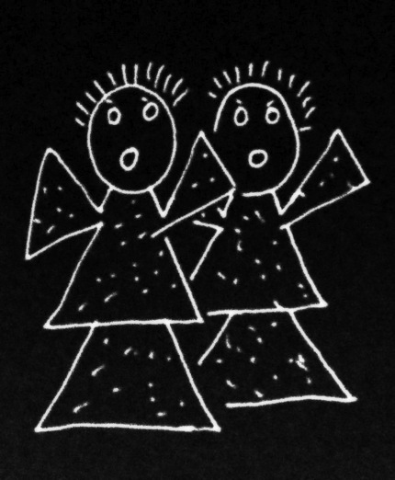
joint
What is the relation between a purposive action and the goal or goals to which it is directed?
Notes:
The same question we asked about ordinary, individual action also arises for joint action.
What is the relation between a purposive joint action and the outcome or outcomes to which it is directed?

Slide 12
joint
What is the relation between a purposive action and the goal or goals to which it is directed?
joint
amuse
action
act
free
smash
alarm
Notes:
And again the question has two aspects.
What singles out the outcome or outcomes to which a purposive joint action is directed?

Slide 13
joint
What is the relation between a purposive action and the goal or goals to which it is directed?
joint
amuse
action
act
free
smash
alarm
Notes:
And again the question has two aspects.
What singles out the outcome or outcomes to which a purposive joint action is directed?

Slide 14
joint
What is the relation between a purposive action and the goal or goals to which it is directed?
wave
joint
amuse
action
reach
act
free
grasp
smash
alarm
scratch
Notes:
And what binds together the various activities that make up the joint action?
The difference in the case of joint action is, of course, that these activities are not necessarily activities of a single agent.

Slide 15
joint
What is the relation between a purposive action and the goal or goals to which it is directed?
wave
joint
amuse
action
reach
act
free
grasp
smash
shared intention
alarm
scratch
Notes:
The answer to this question for the case of joint action is also superficially similar in the answer we gave in the case of ordinary, individual action.
A shared intention is what relates purposive joint actions to the outcomes to which they are directed.
For the shared intention
(1) involves a representation, on the part of each agent, of an outcome
(2) coordinates the several agents’ activities
and
(3) coordinates the several agents’ activities in such a that would normally facilitate the occurrence of the represented outcome.
It is in this sense that a shared intention can ground the purposiveness of a joint action.

Slide 16
joint
What is the relation between a purposive action and the goal or goals to which it is directed?
wave
joint
amuse
action
reach
act
free
coordinates
represents
grasp
smash
shared intention
alarm
scratch
Notes:
The answer to this question for the case of joint action is also superficially similar in the answer we gave in the case of ordinary, individual action.
A shared intention is what relates purposive joint actions to the outcomes to which they are directed.
For the shared intention
(1) involves a representation, on the part of each agent, of an outcome
(2) coordinates the several agents’ activities
and
(3) coordinates the several agents’ activities in such a that would normally facilitate the occurrence of the represented outcome.
It is in this sense that a shared intention can ground the purposiveness of a joint action.

Slide 17
joint
What is the relation between a purposive action and the goal or goals to which it is directed?
???
wave
joint
amuse
action
reach
act
free
coordinates
represents
grasp
smash
shared intention
alarm
scratch
Notes:
But what we saw earlier, what the research by Kourtis et al and others indicates, is that social motor representation can play a similar role to joint action.
Return to the example of a two agents moving an object in a way that involves passing it between them.
the motor representation
(1) involves a representation, on the part of each agent, of an outcome
In this case the outcome is the whole movement of the object
(2) coordinates the several agents’ activities
and
(3) coordinates the several agents’ activities in such a that would normally facilitate the occurrence of the represented outcome.
Because each agent represents the whole movement and plans all of its implementation irrespective of which parts she will actually perform, each agent plans the action in a way that should coordinate with the other agent’s plans providing they use similar planning procedures
[*What I’m saying here, in effect, is that both shared intention and social motor representation can yield a COLLECTIVE GOAL]

Slide 18
G is a distributive goal: it is an outcome to which each agent’s actions are individually directed and it is possible that: all actions succeed relative to this outcome.

Slide 19
Merely Parallel Individual Agency
Shared Agency
G is a distributive goal: it is an outcome to which each agent’s actions are individually directed and it is possible that: all actions succeed relative to this outcome.
Members of a flash mob simultaneously open their newspapers noisily
Onlookers simultaneously open their newspapers noisily
(cf. Searle 1990: 92)
Two friends walk to the metro station together.
Two strangers walk the same route side-by-side.
(Gilbert 1990)
Notes:
The notion of a distributive goal is already sufficient to deal with the contrast cases ... looks like we’re making real progress

Slide 20
G is a distributive goal: it is an outcome to which each agent’s actions are individually directed and it is possible that: all actions succeed relative to this outcome.
Notes:
... but there’s a problem ...

Slide 21
G is a distributive goal: it is an outcome to which each agent’s actions are individually directed and it is possible that: all actions succeed relative to this outcome.
Nora’s shooting
Fred’s death
Olive’s shooting
Fred’s killing
Notes:
... but it’s much too broad! (Nora & Olive’s shooting Fred is a contrast case)

Slide 22
G is a distributive goal: it is an outcome to which each agent’s actions are individually directed and it is possible that: all actions succeed relative to this outcome.
Nora’s shooting
Two friends walk to the metro station together.
Two strangers walk the same route side-by-side.
Fred’s death
(Gilbert 1990)
Olive’s shooting
Nora and Olive, deadly enemies, kill Fred.
Two friends collaboratively kill Fred.
Fred’s killing
Notes:
so we need to add to our list of contrast cases

Slide 23
G is a distributive goal: it is an outcome to which each agent’s actions are individually directed and it is possible that: all actions succeed relative to this outcome.
G is a collective goal
(a) it is a distributive goal;
(b) the actions are coordinated; and
(c) coordination of this type would normally facilitate occurrences of outcomes of this type.

Slide 24
G is a distributive goal: it is an outcome to which each agent’s actions are individually directed and it is possible that: all actions succeed relative to this outcome.
G is a collective goal
(a) it is a distributive goal;
(b) the actions are coordinated; and
(c) coordination of this type would normally facilitate occurrences of outcomes of this type.

Slide 25


Slide 26
sting
sting
sting
sting
sting
death of fly
sting
sting
sting

Slide 27
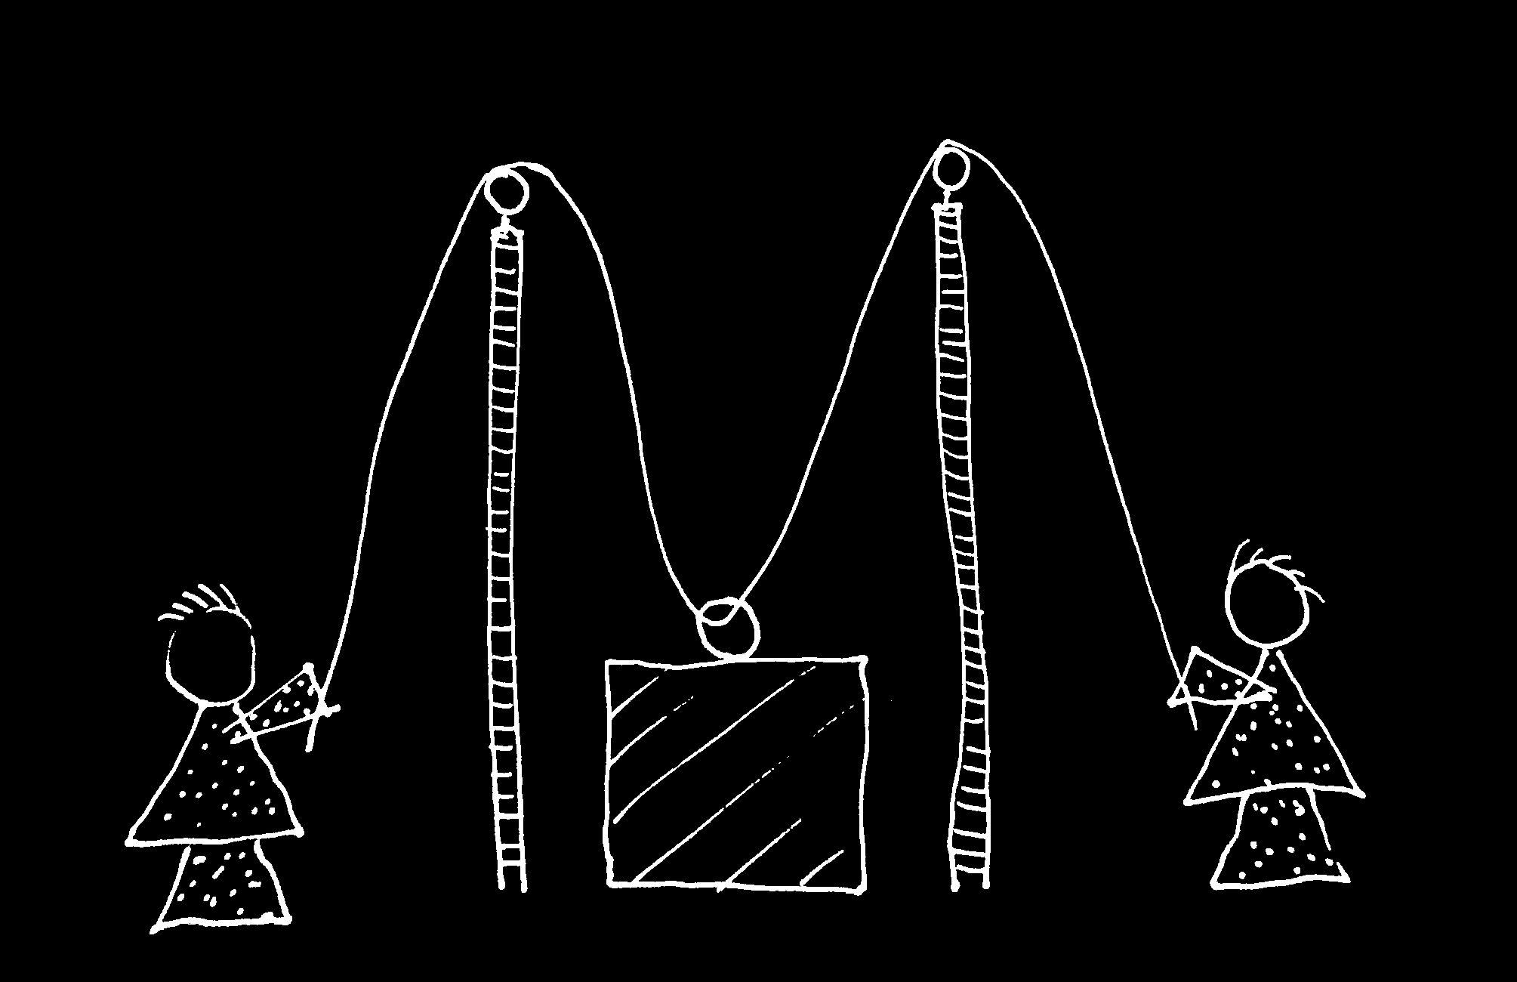

Slide 28
G is a distributive goal: it is an outcome to which each agent’s actions are individually directed and it is possible that: all actions succeed relative to this outcome.
G is a collective goal
(a) it is a distributive goal;
(b) the actions are coordinated; and
(c) coordination of this type would normally facilitate occurrences of outcomes of this type.
Notes:
... collective goal doesn’t enable us to draw this distinction ...

Slide 29
G is a distributive goal: it is an outcome to which each agent’s actions are individually directed and it is possible that: all actions succeed relative to this outcome.
G is a collective goal
(a) it is a distributive goal;
(b) the actions are coordinated; and
(c) coordination of this type would normally facilitate occurrences of outcomes of this type.
“It ... seems useful to draw a distinction between elementary or thin forms of joint action common to humans and other social mammals and sophisticated or thick forms of joint action, perhaps unique to the human species.”
(Pacherie & Dokic 2006, 110)
Notes:
... collective goal doesn’t enable us to draw this distinction ...

Slide 30
premise:
Some joint actions are facilitated by the agents engaging in
reciprocal, parallel agent-neutral motor planning
for outcomes whose realisation would normally involve action on the part of each agent,
where the resulting plans are identical (or similar enough).
Notes:
I’m going to start from a premise which is rightly controversial: reciprocal agent-neutral motor representation enables joint action

Slide 31
premise:
Some joint actions are facilitated by the agents engaging in
reciprocal, parallel agent-neutral motor planning
for outcomes whose realisation would normally involve one’s own and another’s (or others’) actions.
where the resulting plans are identical (or similar enough).
Notes:
I’m going to start from a premise which is rightly controversial: reciprocal agent-neutral motor representation enables joint action

Slide 32
premise:
Some joint actions are facilitated by the agents engaging in
reciprocal, parallel agent-neutral motor planning
for outcomes whose realisation would normally involve one’s own and another’s (or others’) actions.
Notes:
I’m going to start from a premise which is rightly controversial: reciprocal agent-neutral motor representation enables joint action

Slide 33
premise:
Some joint actions are facilitated by the agents engaging in
reciprocal, parallel agent-neutral motor planning
for outcomes whose realisation would normally involve one’s own and another’s (or others’) actions.
Notes:
I’m going to start from a premise which is rightly controversial: reciprocal agent-neutral motor representation enables joint action

Slide 34
premise:
Some joint actions are facilitated by the agents engaging in
reciprocal, parallel agent-neutral motor planning
for outcomes whose realisation would normally involve one’s own and another’s (or others’) actions.
Notes:
I’m going to start from a premise which is rightly controversial: reciprocal agent-neutral motor representation enables joint action

Slide 35
premise:
Some joint actions are facilitated by the agents engaging in
reciprocal, parallel agent-neutral motor planning
for outcomes whose realisation would normally involve one’s own and another’s (or others’) actions.
Notes:
I’m going to start from a premise which is rightly controversial: reciprocal agent-neutral motor representation enables joint action

Slide 36
premise:
Some joint actions are facilitated by the agents engaging in
reciprocal, parallel agent-neutral motor planning
for outcomes whose realisation would normally involve one’s own and another’s (or others’) actions.
Notes:
I’m going to start from a premise which is rightly controversial: reciprocal agent-neutral motor representation enables joint action

Slide 37
premise:
Some joint actions are facilitated by the agents engaging in
reciprocal, parallel agent-neutral motor planning
for outcomes whose realisation would normally involve one’s own and another’s (or others’) actions.
Notes:
I’m going to start from a premise which is rightly controversial: reciprocal agent-neutral motor representation enables joint action

Slide 38
Move it from there to here
Notes:
Let’s step back and consider an individual action.
An agent moves a mug from one place to another, passing in from her left hand to her right hand half way [*demonstrate].
It’s a familiar idea that motor representations for planning and monitoring action involve an hierarchical structure,
where there is a relatively abstract representation of an outcome that is progressively filled in.

Slide 39
Move it from there to here
get it
move it
position it
hand-1
reach
grasp
move
arrive
release
hand-2
reach
grasp
move
place
release
Notes:
So motor planning involves starting with relatively abstract representations of outcomes and filling in details ...

Slide 40
Move it from there to here
get it
move it
position it
hand-1
reach
grasp
move
arrive
release
hand-2
reach
grasp
move
place
release
Notes:
And there is a need, even for a single agent, to synchronize actions in time and space; in this case because there’s an exchange between the two hands.
How is this relevant to the case of joint action?

Slide 41
joint action: same goal
Move it from there to here
get it
move it
position it
hand-1
reach
grasp
move
arrive
release
hand-2
reach
grasp
move
place
release
Notes:
In joint action the agents have the same goal, to move the object from there to here.

Slide 42
joint action: same goal
Move it from there to here
get it
move it
position it
hand-1
reach
grasp
move
arrive
release
hand-2
reach
grasp
move
place
release
similar timing problem
Notes:
They also face a similar coordination problem, requiring a precisely timed swap

Slide 43
joint action: same goal
Move it from there to here
get it
move it
position it
same planning
hand-1
reach
grasp
move
arrive
release
hand-2
reach
grasp
move
place
release
similar timing problem
Notes:
And Koutis et al’s findings (and others’ findings) suggest that the same planning in involved in the joint action case, almost up to the actual muscle contractions.
That is, in the joint action situation each agent plans both agents’ actions as if they were the actions of a single agent.
This may be what enables them to coordinate so well : each is able to plan her own actions in a way that meshes with the other agent’s actions because each agent is planning (and monitoring) both their actions almost as if a single agent were going to execute the whole action.
And of course this is exactly what we want for small-scale joint action---we want two or more agents to act as one.

Slide 44
joint action: same goal
Move it from there to here
get it
move it
position it
same planning
hand-1
reach
grasp
move
arrive
release
hand-2
reach
grasp
move
place
release
prevention needed
similar timing problem
Notes:
So what is the difference between the individual and the joint case? From the point of view of motor representation, the primary difference may be that in joint action there is a need to inhibit execution of the parts of the action which are not one’s own.
Here then is the basic idea I take to be guiding Kourtis and others.
The idea is that coordination is sometimes achieved by having each agent’s motor system plan all of their actions;
given some assumptions, this could be a way of making it likely that each will execute their part in the joint action in a way that meshes with the way the other agents execute their parts.

Slide 45
G is a distributive goal: it is an outcome to which each agent’s actions are individually directed and it is possible that: all actions succeed relative to this outcome.
shared motor action
G is a collective goal
(a) it is a distributive goal;
(b) the actions are coordinated; and
(c) coordination of this type would normally facilitate occurrences of outcomes of this type.
1. we each have a motor representation of G;
2. we are each disposed to inhibit some (not all) of the resulting planning or actions;
3. we each expect that if G occurs, we will all be agents of its occurrence; and
4. (1) and (2) because (3)

Slide 46
joint
What is the relation between a purposive action and the goal or goals to which it is directed?
wave
joint
amuse
action
reach
act
free
coordinates
represents
grasp
smash
shared intention or shared motor representation
alarm
scratch
Notes:
But what we saw earlier, what the research by Kourtis et al and others indicates, is that social motor representation can play a similar role to joint action.
Return to the example of a two agents moving an object in a way that involves passing it between them.
the motor representation
(1) involves a representation, on the part of each agent, of an outcome
In this case the outcome is the whole movement of the object
(2) coordinates the several agents’ activities
and
(3) coordinates the several agents’ activities in such a that would normally facilitate the occurrence of the represented outcome.
Because each agent represents the whole movement and plans all of its implementation irrespective of which parts she will actually perform, each agent plans the action in a way that should coordinate with the other agent’s plans providing they use similar planning procedures
[*What I’m saying here, in effect, is that both shared intention and social motor representation can yield a COLLECTIVE GOAL]

Slide 47
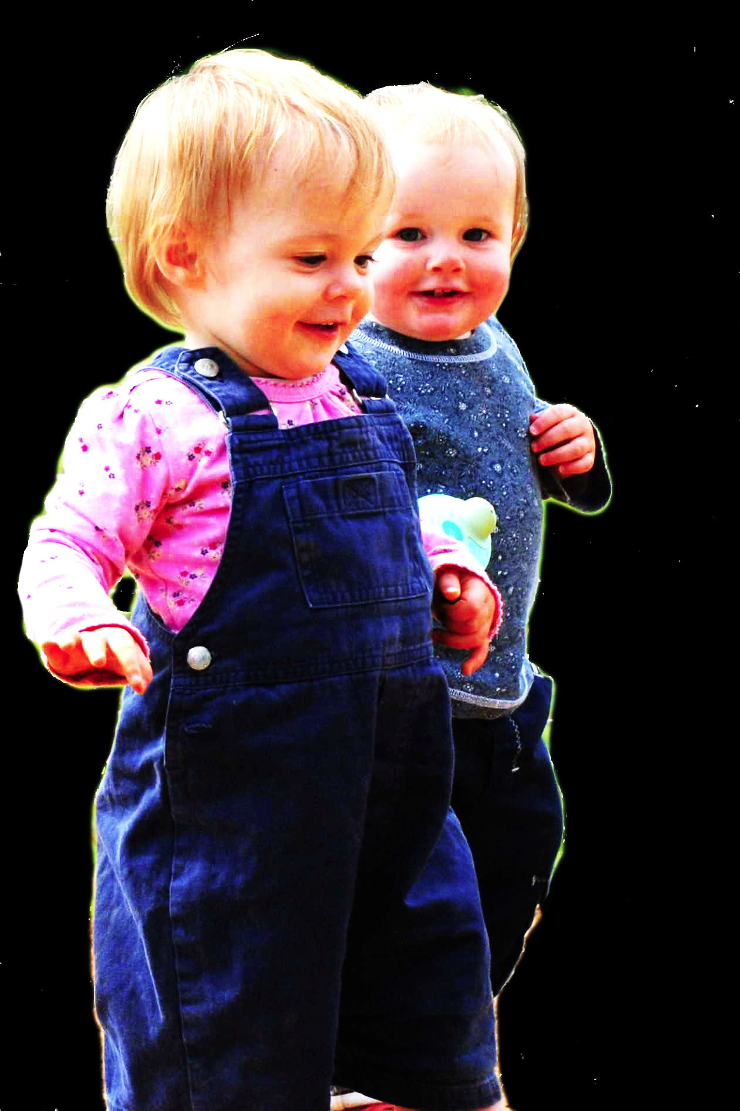
1. All shared agency involves shared intention.
2. Shared intention requires sophisticated mindreading.
Therefore:
conjecture
3.
The prior existence of capacities for shared agency partially explains how sophisticated forms of mindreading emerge in evolution or development (or both)
cannot explain

Slide 48
conjecture
The prior existence of capacities for shared agency partially explains how sophisticated forms of mindreading emerge in evolution or development (or both)

Slide 49
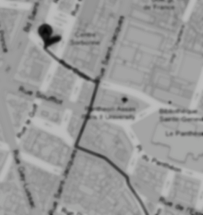
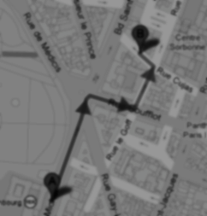
< different content >
Notes:
As background we first need a generic distinction between content and format. Imagine you are in an unfamiliar city and are trying to get to the central station. A stranger offers you two routes. Each route could be represented by a distinct line on a paper map. The difference between the two lines is a difference in content. Each of the routes could alternatively have been represented by a distinct series of instructions written on the same piece of paper; these cartographic and propositional representations differ in format. The format of a representation constrains its possible contents. For example, a representation with a cartographic format cannot represent what is represented by sentences such as `There could not be a mountain whose summit is inaccessible.'\footnote{ Note that the distinction between content and format is orthogonal to issues about representational medium. The maps in our illustration may be paper map or electronic maps, and the instructions may be spoken, signed or written. This difference is one of medium.} The distinction between content and format is necessary because, as our illustration shows, each can be varied independently of the other.

Slide 50
Head southeast on Rue Cujas toward Rue Victor Cousin. Turn right onto Rue Saint-Jacques. ...
Take RER B and get out at the Luxembourg station, from there it's less than 5 minutes walk.
< different format >
< different content >
Notes:
As background we first need a generic distinction between content and format. Imagine you are in an unfamiliar city and are trying to get to the central station. A stranger offers you two routes. Each route could be represented by a distinct line on a paper map. The difference between the two lines is a difference in content. Each of the routes could alternatively have been represented by a distinct series of instructions written on the same piece of paper; these cartographic and propositional representations differ in format. The format of a representation constrains its possible contents. For example, a representation with a cartographic format cannot represent what is represented by sentences such as `There could not be a mountain whose summit is inaccessible.'\footnote{ Note that the distinction between content and format is orthogonal to issues about representational medium. The maps in our illustration may be paper map or electronic maps, and the instructions may be spoken, signed or written. This difference is one of medium.} The distinction between content and format is necessary because, as our illustration shows, each can be varied independently of the other.

Slide 51
Head southeast on Rue Cujas toward Rue Victor Cousin. Turn right onto Rue Saint-Jacques. ...
=
?
Notes:
Format matters because only where two representations have the same format can they be straightforwardly inferentially integrated.
To illustrate, let’s stay with representations of routes.
Suppose you are given some verbal instructions describing a route. You are then shown a representation of a route on a map and asked whether this is the same route that was verbally described. You are not allowed to find out by following the routes or by imagining following them.
Special cases aside, answering the question will involve a process of translation because two distinct representational formats are involved, propositional and cartographic. It is not be enough that you could follow either representation of the route. You will also need to be able to translate from at least one representational format into at least one other format.

Slide 52
The Interface Problem:

Slide 53
The Interface Problem:
Some joint actions involve both shared intention and shared motor representation

Slide 54
The Interface Problem:
Shared motor representations:
i. represent outcomes;
ii. ground the purposiveness of some
joint actions
Some joint actions involve both shared intention and shared motor representation

Slide 55
The Interface Problem:
Shared motor representations:
i. represent outcomes;
ii. ground the purposiveness of some
joint actions
Two outcomes, A and B, match in a particular context just if, in that context, either the occurrence of A would normally constitute or cause, at least partially, the occurrence of B or vice versa.
Some joint actions involve both shared intention and shared motor representation

Slide 56
The Interface Problem:
How are non-accidental matches possible?
Shared motor representations:
i. represent outcomes;
ii. ground the purposiveness of some
joint actions
Two outcomes, A and B, match in a particular context just if, in that context, either the occurrence of A would normally constitute or cause, at least partially, the occurrence of B or vice versa.
Some joint actions involve both shared intention and shared motor representation

Slide 57
The Interface Problem:
How are non-accidental matches possible?
Shared motor representations:
i. represent outcomes;
ii. ground the purposiveness of some
joint actions; and
iii. differ in format from (the constituent attitudes of) shared intentions.
Two outcomes, A and B, match in a particular context just if, in that context, either the occurrence of A would normally constitute or cause, at least partially, the occurrence of B or vice versa.
Some joint actions involve both shared intention and shared motor representation

Slide 58
The Interface Problem:
How are non-accidental matches possible?
Shared motor representations:
i. represent outcomes;
ii. ground the purposiveness of some
joint actions; and
iii. differ in format from (the constituent attitudes of) shared intentions.
Two outcomes, A and B, match in a particular context just if, in that context, either the occurrence of A would normally constitute or cause, at least partially, the occurrence of B or vice versa.
Some joint actions involve both shared intention and shared motor representation
Notes:
interface problem arises in the individual case as well as the joint case, of course ...

Slide 59
The Interface Problem:
How are non-accidental matches possible?
Shared motor representations:
i. represent outcomes;
ii. ground the purposiveness of some
joint actions; and
iii. differ in format from (the constituent attitudes of) shared intentions.
Two outcomes, A and B, match in a particular context just if, in that context, either the occurrence of A would normally constitute or cause, at least partially, the occurrence of B or vice versa.
Some joint actions involve both shared intention and shared motor representation
Notes:
Think first about how we might solve it in the individual case

Slide 60
Head southeast on Rue Cujas toward Rue Victor Cousin. Turn right onto Rue Saint-Jacques. ...
=
?
Notes:
There is a way to make the problem of comparison between representational formats trivial

Slide 61
Follow that route
=
?
Notes:
Suppose one representation involves a demonstrative that refers by deferring to another representation

Slide 62
Follow that route
=
?
Notes:
Then the comparison doesn’t require translation between formats after all.
Maybe the same can be true for intentions and motor representations.
Maybe intentions can involve demonstrative concepts which refer to actions by deferring to motor representations?
[*cut:
Set that aside, suppose it can be solved --- essentially because MR must give rise to experience of action.
On this view, it is demonstrative deference to motor representation that connects intentions to bodily movements.
Only by recognising how intentions interlock with motor representations can we hope to understand how our intentions ever make a difference to the world around us.
On this view experience of action plays a novel role.
Action experiences in which motor representations feature, such as those associated with motor imagery and those associated with really acting, are arguably necessary for there to be concepts which are constituents of intentions and refer to actions by deferring to motor representations.
But if, as we conjecture, such deference is necessary for intentions to properly and reliably result in bodily movements, it may turn out that intentionally acting in the world de- pends on action experiences featuring motor representation.
Much as on some views thought about objects depends on perceptual experience (e.g. Campbell 2002), so also intending actions may depend on motor experience.

Slide 63
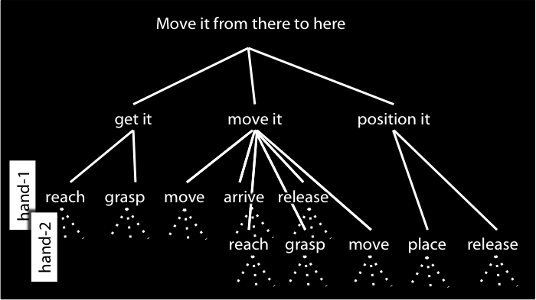
Do that
=
?
Notes:
But we can’t point to motor representations like we can point to maps!
What we need for reference by deference to a motor representation is experience of motor action.
And if you think about motor imagination it seems quite plausible that we do have such experiences.
So here’s the thought:
There are no direct inferential connections between intentions and motor representations.
Harmony is ensured by the fact that where an intention involves a bodily movement, either executing that intention involves forming a further intention or else the intention involves a demonstrative that refers to an action by deferring to a motor representation.
So what connects intentions to motor representations---what connects the reflective to the pre-reflective---is the use of demonstratives, and this depends on experience of motor action.
Much as on some views all thought about objects ultimately depends on perceptual experience (e.g. Campbell 2002), so also intending bodily actions may ultimately depend on motor experience.
Experience anchors the reflective in the pre-reflective.

Slide 64
The Interface Problem:
How are non-accidental matches possible?
Shared motor representations:
i. represent outcomes;
ii. ground the purposiveness of some
joint actions; and
iii. differ in format from (the constituent attitudes of) shared intentions.
Two outcomes, A and B, match in a particular context just if, in that context, either the occurrence of A would normally constitute or cause, at least partially, the occurrence of B or vice versa.
Some joint actions involve both shared intention and shared motor representation
Notes:
This might work for the individual case. But does it also work for the joint case?

Slide 65
The Interface Problem:
How are non-accidental matches possible?
Shared motor representations:
i. represent outcomes;
ii. ground the purposiveness of some
joint actions; and
iii. differ in format from (the constituent attitudes of) shared intentions.
Two outcomes, A and B, match in a particular context just if, in that context, either the occurrence of A would normally constitute or cause, at least partially, the occurrence of B or vice versa.
Some joint actions involve both shared intention and shared motor representation
Notes:
Formally I think there’s no problem at all with the idea that shared intentions involve demonstrative reference to actions by deferring to component representations of social motor representations.
But for this to work, the component representations of social motor representations and the actions they cause have to be experienced in some way.
I’m not at all sure if this is right; to be honest I’ve only just started thinking about it.
But it is an intriguing idea that there we can experience actions which are not entirely our own, and it might just be true that these experiences, by enabling demonstrative reference, are what connect shared intentions with social motor representations.
Here’s the beautiful thing.
Social motor representations are just structures of ordinary motor representations.
There’s no social magic here, no mystical ingredient needed to glue joint actions together.
If we suppose, similarly, that shared intentions are structures of ordinary intentions and knowledge states
then it seems to me that the solving the interface problem for the individual case already provides a solution to the joint case as well.
So recognizing social motor representations as grounding the purposiveness of some joint actions does create an interface problem; but as far as I can tell, it doesn’t create a problem distinct from the problem that we already have by recognizing that motor representations ground the purposiveness of actions more generally.
There is a problem here, I think, but it isn’t specifically about either joint or individual action.

Slide 66
Notes:
Formally I think there’s no problem at all with the idea that shared intentions involve demonstrative reference to actions by deferring to component representations of social motor representations.
But for this to work, the component representations of social motor representations and the actions they cause have to be experienced in some way.
I’m not at all sure if this is right; to be honest I’ve only just started thinking about it.
But it is an intriguing idea that there we can experience actions which are not entirely our own, and it might just be true that these experiences, by enabling demonstrative reference, are what connect shared intentions with social motor representations.
Here’s the beautiful thing.
Social motor representations are just structures of ordinary motor representations.
There’s no social magic here, no mystical ingredient needed to glue joint actions together.
If we suppose, similarly, that shared intentions are structures of ordinary intentions and knowledge states
then it seems to me that the solving the interface problem for the individual case already provides a solution to the joint case as well.
So recognizing social motor representations as grounding the purposiveness of some joint actions does create an interface problem; but as far as I can tell, it doesn’t create a problem distinct from the problem that we already have by recognizing that motor representations ground the purposiveness of actions more generally.
There is a problem here, I think, but it isn’t specifically about either joint or individual action.

Slide 67


Slide 68

Planning Others’ Actions
(slides from Natalie Sebanz)
Kourtis et al., subm.
‘interaction partners ... not only represent their own part of the joint task but also generate a representation of their co- actor’s part’
(Kourtis et al 2012: 8)

Slide 69
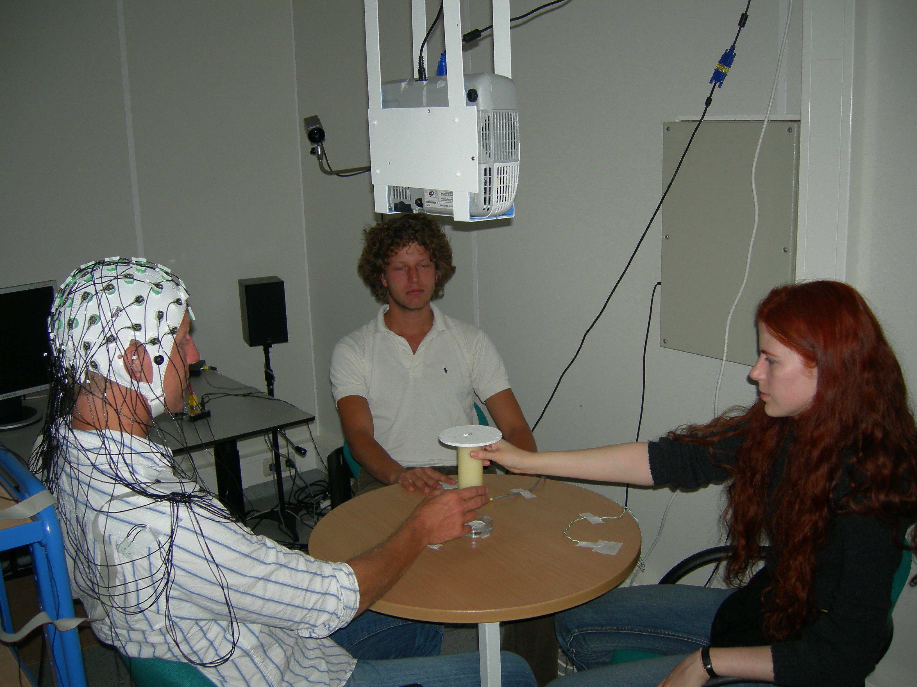
Kourtis et al., subm.

Slide 70
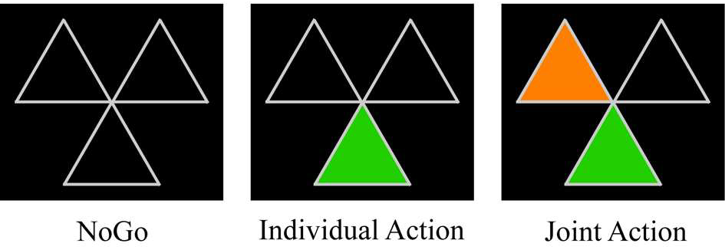
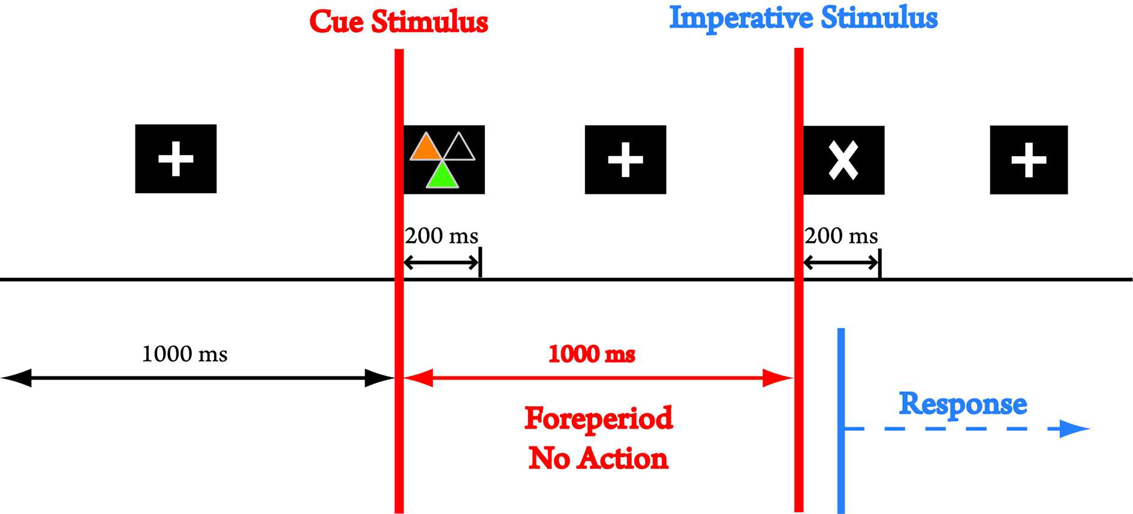
Joint Planning
Kourtis et al., subm.

Slide 71
Joint Planning
Kourtis et al., subm.

Slide 72
Joint Planning
Kourtis et al., subm.

Slide 73
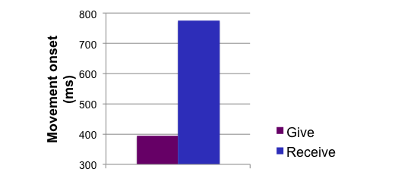
Kourtis et al., subm.

Slide 74
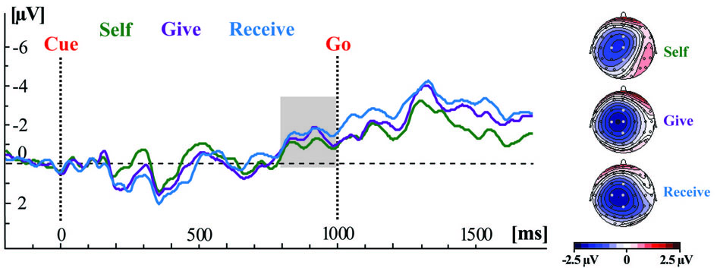
Kourtis et al., subm.

Slide 76
Planning others’ actions can inform planning for one’s own
(slides from Cordula Vesper)
Joint jumping task (performance): „Land at the same time!“
Distance difference
*
closer
140 cm
140 cm
farther
105 cm
105 cm
70 cm
70 cm
35 cm
35 cm
individual
joint
individual
joint

Slide 77
Imagery
Joint jumping imagery
Task: “Imagine to jump while landing at the same time as another person on the other side of the occluder!”
Measurement: Self-reported duration of imagined jump

Slide 78
Imagery
Adaptation of jump duration: scaled to difference in jump distance
Role distribution: only closer person adapts
Specific for coordination: no modulation in individual
EXPERIMENT 1: IMAGERY
Distance difference
*
closer
farther
individual
joint
individual
joint

Slide 80
In some joint actions, the agents have a single representation of the whole outcome
(slides from Natalie Sebanz)

Slide 81
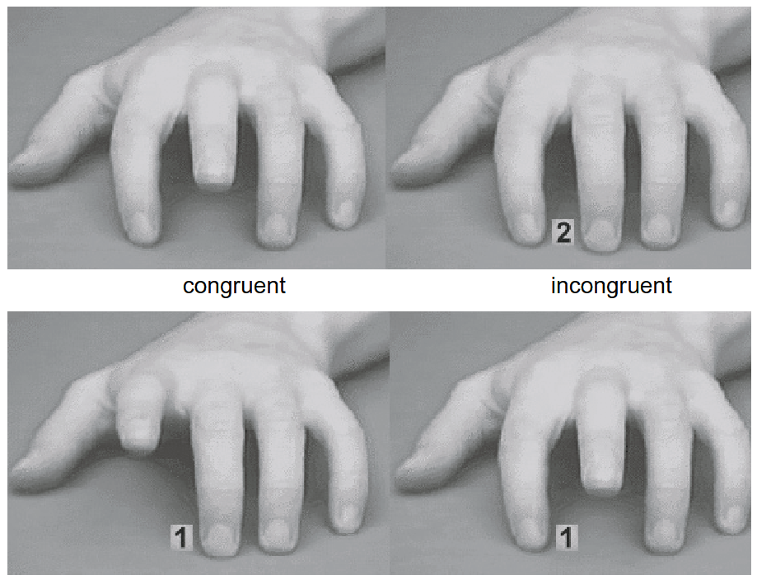
Group-level action planning?
Experimental paradigm is based on the phenomenon of ‘perception-action matching’: Observing an action creates a tendency to perform this action. That is, individual action plans are activated based on the observation of individual actions.
As a consequence, performing an action that is similar to the observed action is easy while performing an action that is opposite to the observed action is more difficult (e.g., Brass et al., 2001).

Slide 82

Group-level action planning?
If co-actors form group-level action plans, then observing joint action should create a tendency to perform joint actions (perception-action matching at an inter-group level).
It should be more difficult to perform joint actions when observing individual actions.

Slide 83
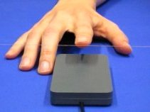
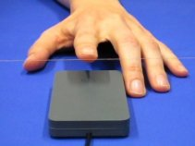

Slide 84
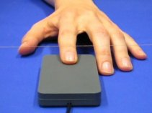
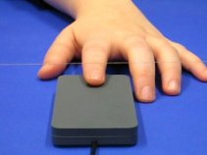
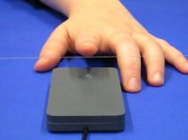

Slide 85
Participant´s task is to press a key when the right hand is moving.
Congruent condition: Confederate moves when left hand is moving and when both hands are moving.
C
P

Slide 86
C

Slide 88
P

Slide 90
C
P

Slide 91
Participant´s task is to press a key when the right hand is moving.
Inongruent condition: Confederate moves when left hand is moving and when right hand is moving, but not when both hands are moving.
C
P

Slide 92
C

Slide 94
C
P

Slide 96
P

Slide 98
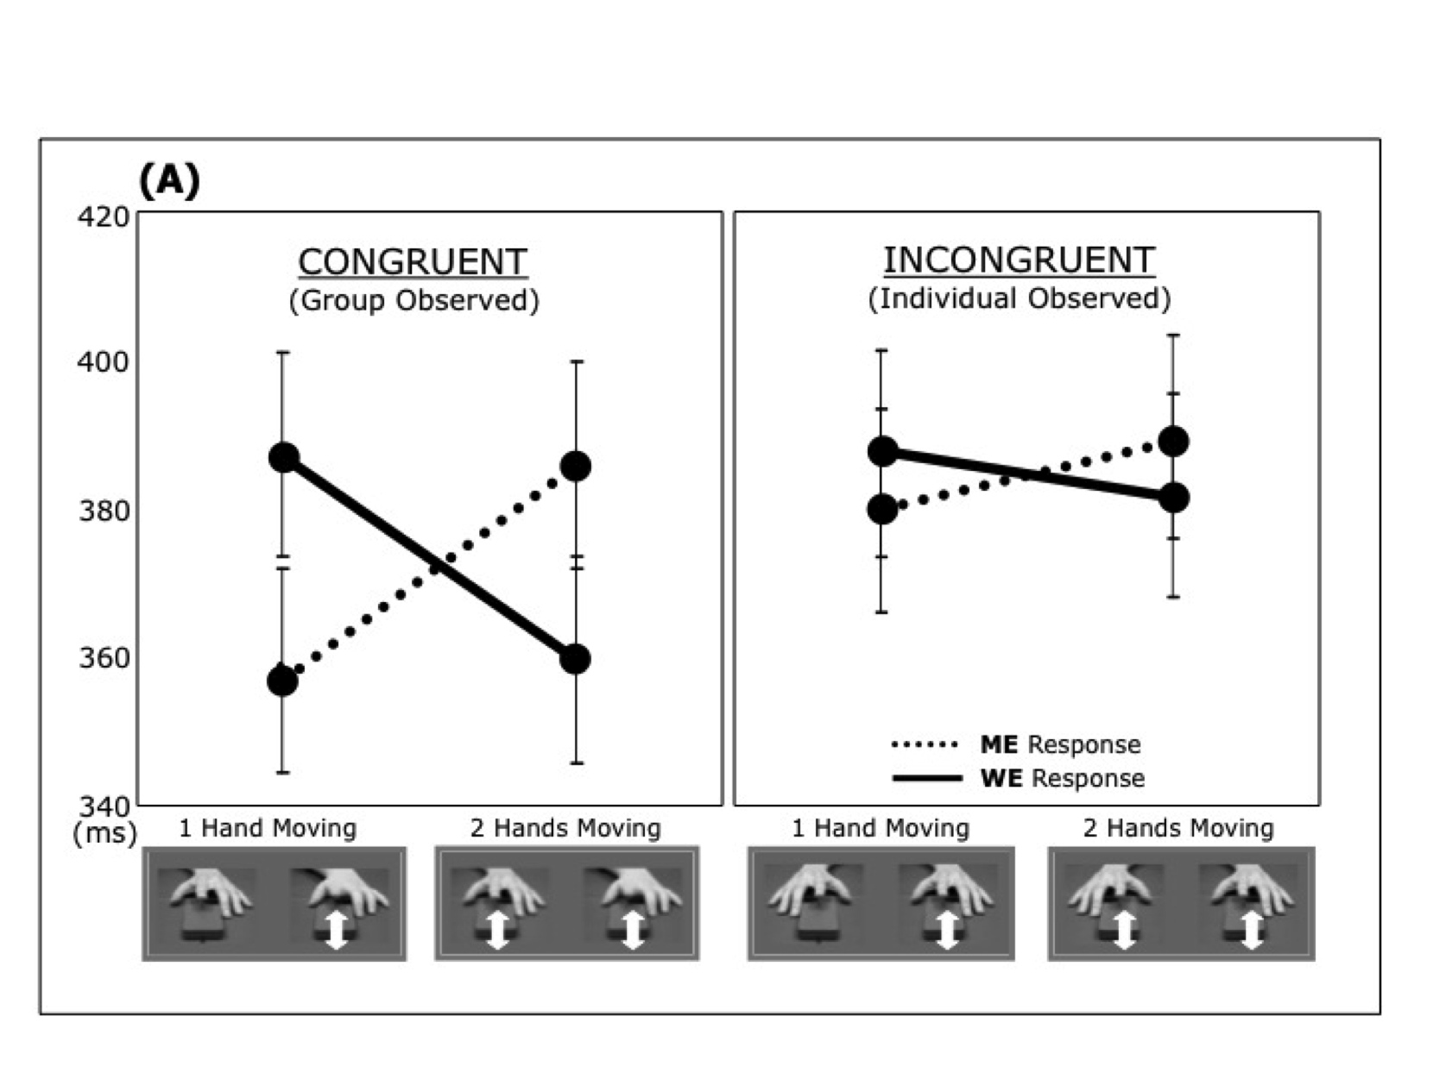
Tsai, Sebanz, & Knoblich, 2011, Cognition
(A)
we
me
(ms)

Slide 99
Tsai, Sebanz, & Knoblich, 2011, Cognition
(A)
(ms)

Slide 100
Tsai, Sebanz, & Knoblich, 2011, Cognition
(A)
(ms)

Slide 101
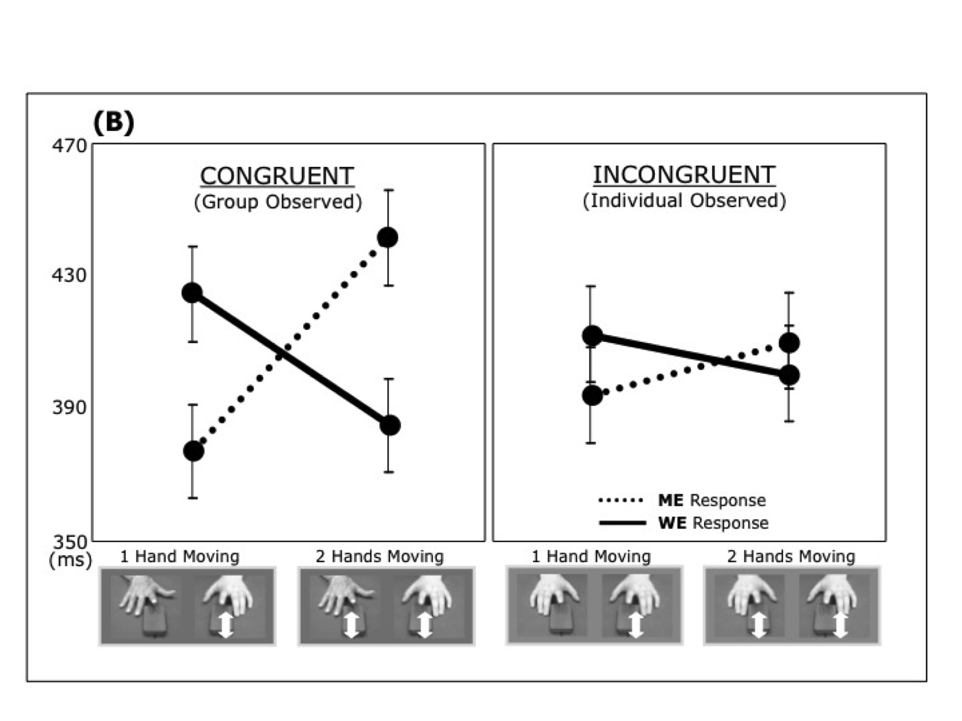
Tsai, Sebanz, & Knoblich, 2011, Cognition

Slide 102
Evidence for…
Perception-action matching at an inter-group level.
Observing actions being performed simultaneously by two agents activates a corresponding action plan. This action plan specifies an agent´s own action in relation to their co-actor´s action (possibly in terms of perceptual events). Performing an individual action in response to an observed joint action is difficult, because the joint action plan activated through joint action observation needs to be replaced by an individual action plan.

Slide 104

Sufficient conditions
We have a shared intention that we J if
“1. (a) I intend that we J and (b) you intend that we J
“2. I intend that we J in accordance with and because of la, lb, and meshing subplans of la and lb; you intend [likewise] …
“3. 1 and 2 are common knowledge between us”
(Bratman 1993: View 4)
Notes:
Let me try another way of presenting the same idea.
Here are Michael Bratman’s sufficient conditions for shared intention.
I want to suggest that social motor representation provides a parallel

Slide 105
Sufficient conditions
We have a shared intention that we J if
“1. (a) I intend that we J and (b) you intend that we J
“2. I intend that we J in accordance with and because of la, lb, and meshing subplans of la and lb; you intend [likewise] …
“3. 1 and 2 are common knowledge between us”
(Bratman 1993: View 4)
Notes:
There is a direct parallel with the first condition: in the case of motor representation, each agent represents the outcome (e.g. the movement of the object).
The key claim here is that some motor representations (i) represent outcomes, and (ii) represent the outcomes of actions not all of whose components will be executed by the agent whose motor representation it is.

Slide 106
Sufficient conditions
We have a shared intention that we J if
“1. (a) I intend that we J and (b) you intend that we J
“2. I intend that we J in accordance with and because of la, lb, and meshing subplans of la and lb; you intend [likewise] …
“3. 1 and 2 are common knowledge between us”
(Bratman 1993: View 4)
Notes:
Here there is clearly no \emph{direct} parallel.
I don’t think motor representations can represent motor representations in the way that intentions can represent intentions.
But I do think there is a parallel of sorts.
Each agent’s having a motor representation of the distributed goal of their action does ensure meshing of subplans.
What ensures this meshing is not the fact that each agent represents the others’ plans.
Rather in the case where joint actions is grounded in social motor representation, what ensures meshing of subplans is two facts (i) each agent plans all of the agents’ actions, and (ii) the agents rely on similar planning strategies (planning strategies that are sufficiently similar to ensure meshing subplans).

Slide 107
Sufficient conditions
We have a shared intention that we J if
“1. (a) I intend that we J and (b) you intend that we J
“2. I intend that we J in accordance with and because of la, lb, and meshing subplans of la and lb; you intend [likewise] …
“3. 1 and 2 are common knowledge between us”
(Bratman 1993: View 4)
Notes:
I’m less sure about a parallel to the common knowledge condition.
As I see things, the justification for supposing that shared intention involves common knowledge concerns a normative link between intention and reasons.
In acting on intentions, one should be acting for reasons.
And a consideration can only be among your reasons if you know that consideration.
So I think the need for common knowledge arises from the need to explain how another person’s intentions could be among your reasons for acting.
I don’t think this need arises in the case of motor representation because it seems to me that the sort of planning of which motor representation is an element does not involve acting for reasons in the same sense.
(In motor action, there are reasons why we do things (of course!) but these are not reasons for which we act.)
What motor joint action requires is not that your motor plans provide reasons for mine.
There just has to be a good chance that this is true relative to the costs and benefits of joint action and the alternatives to joint action.
So I think that instead of common *knowledge*, in the case of social motor representation there is a common *background* of dispositions, habits and expectations.
[***CUT but one thing that might do the work of common knowledge is a custom or habit
that would allow the agents, in their particular social context, to rely on each other’s cooperation.
In some countries this sort of thing works on public transport;
it is reasonable to take for granted that, if you are obviously struggling with a pram or suitcase, then someone nearby will help.]

Slide 108
Sufficient conditions
We have a shared intention that we J if
“1. (a) I intend that we J and (b) you intend that we J
“2. I intend that we J in accordance with and because of la, lb, and meshing subplans of la and lb; you intend [likewise] …
“3. 1 and 2 are common knowledge between us”
(Bratman 1993: View 4)
Notes:
If this is right, if social motor representations play a role analogous to the structure of intentions and knowledge which Bratman identifies as sufficient for shared intention, then this is another reason to think that motor representations can ground the purposiveness of joint action.

Slide 110
joint
What is the relation between a purposive action and the goal or goals to which it is directed?
Notes:
The same question we asked about ordinary, individual action also arises for joint action.
What is the relation between a purposive joint action and the outcome or outcomes to which it is directed?

